Slide 1
Game Presentation
Will Akins, Ryan Fletcher, Simon Goodfellow and James Hopkins

Slide 2
Introduction
2D Post-Apocalyptic run ‘n’ gun game
Gather resources to upgrade equipment
Find new weapons/equipment to upgrade your character
Reach the end of the level to finish and upgrade character
Complete levels before time limit runs out

Slide 3
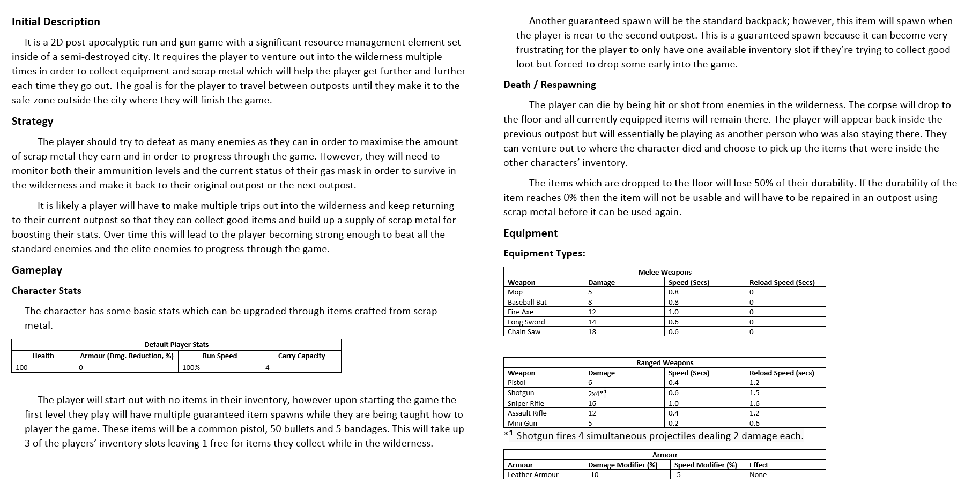
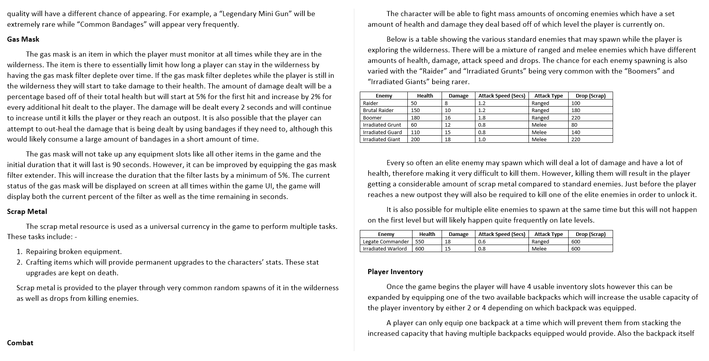
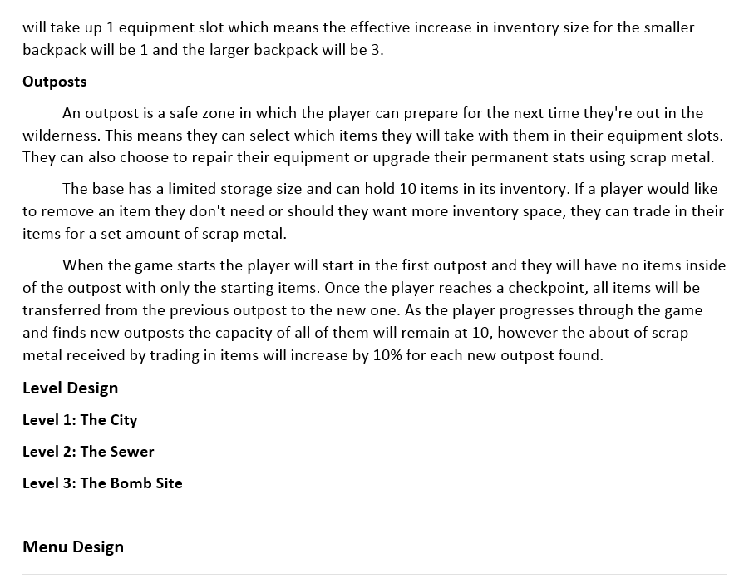
Planning

Slide 4
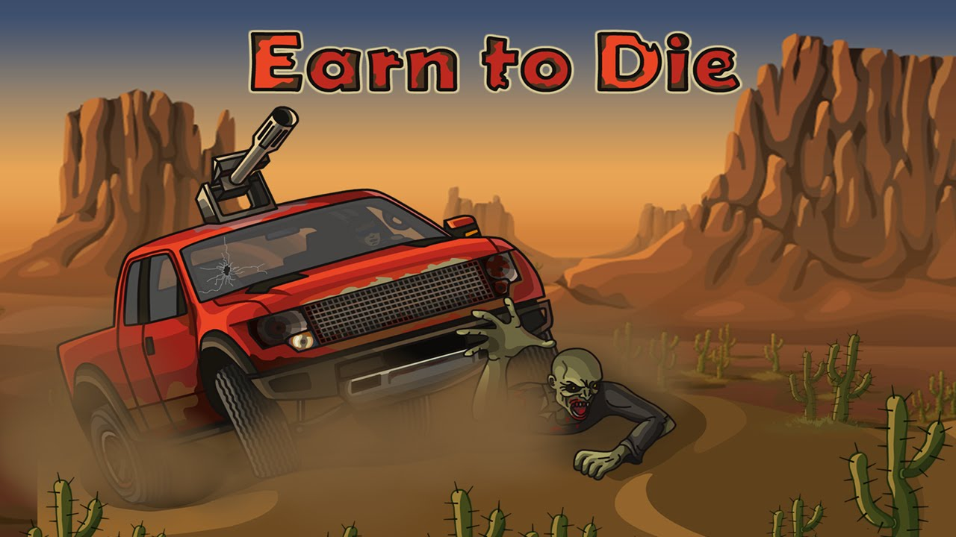
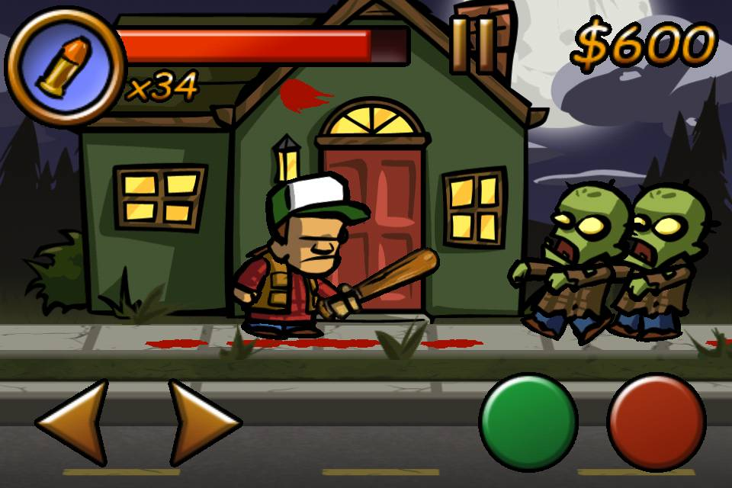
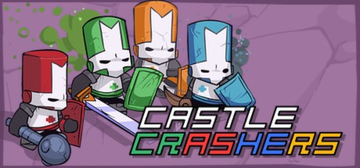
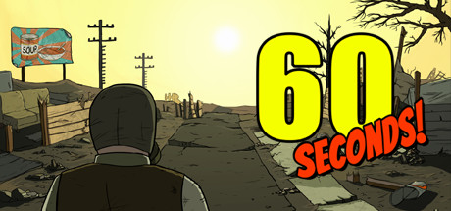
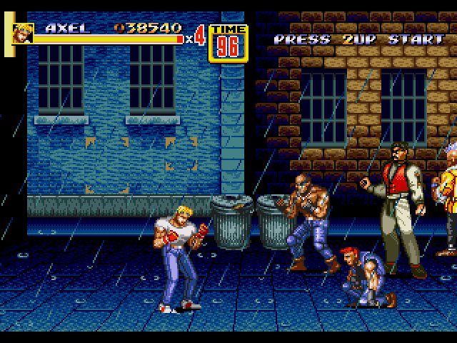
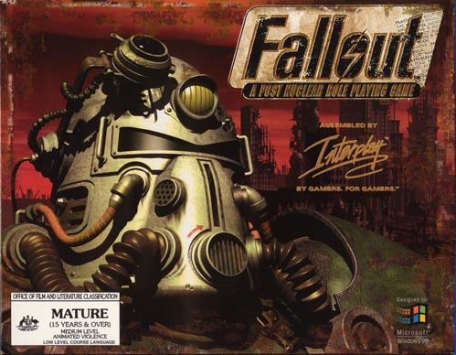
Inspirations

Slide 5
AI
*Insert images of the finished AI code*

Slide 6
Character Design
*Insert images of the finished character design*

Slide 7
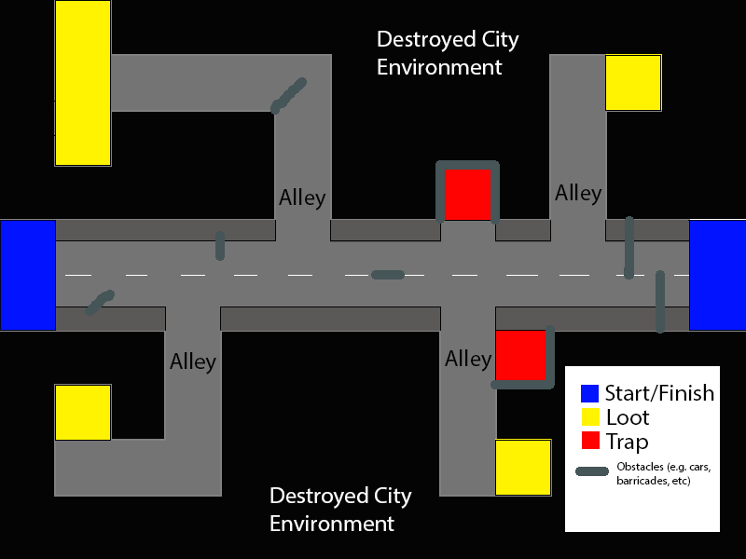
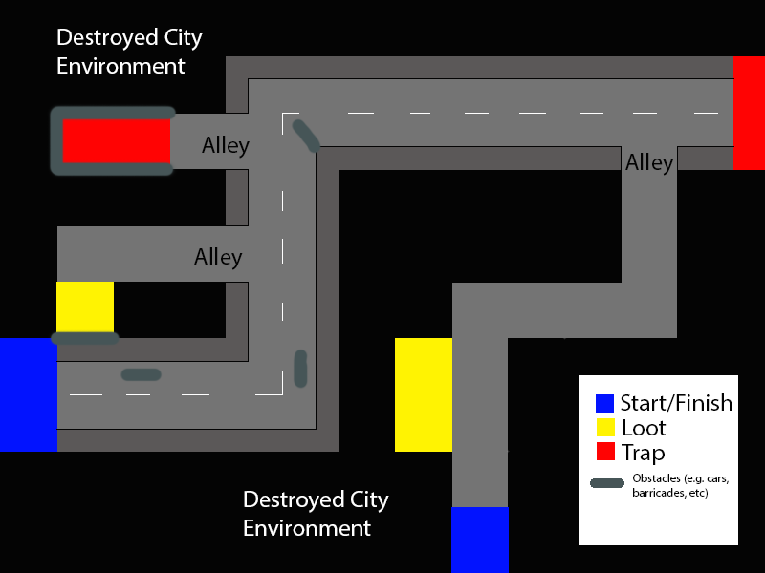
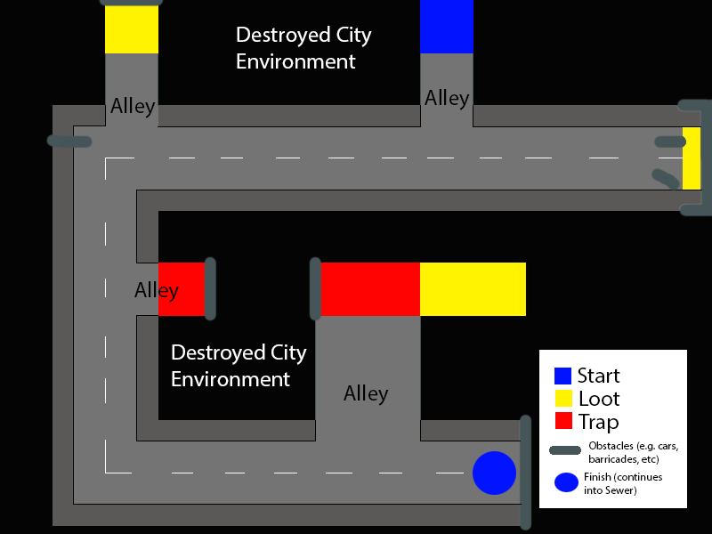
Level Design

Slide 8
Menus
*Insert images of the finished menus*

Slide 9
Equipment System
*Insert images of the finished equipment system*

Slide 10
Issues/Bugs

Slide 11
Extra Features
Extra weapons
Inventory in outpost
Bosses
More levels

